Slide 1


Slide 2

“Multitasking decreases productivity by 40%”

Slide 3
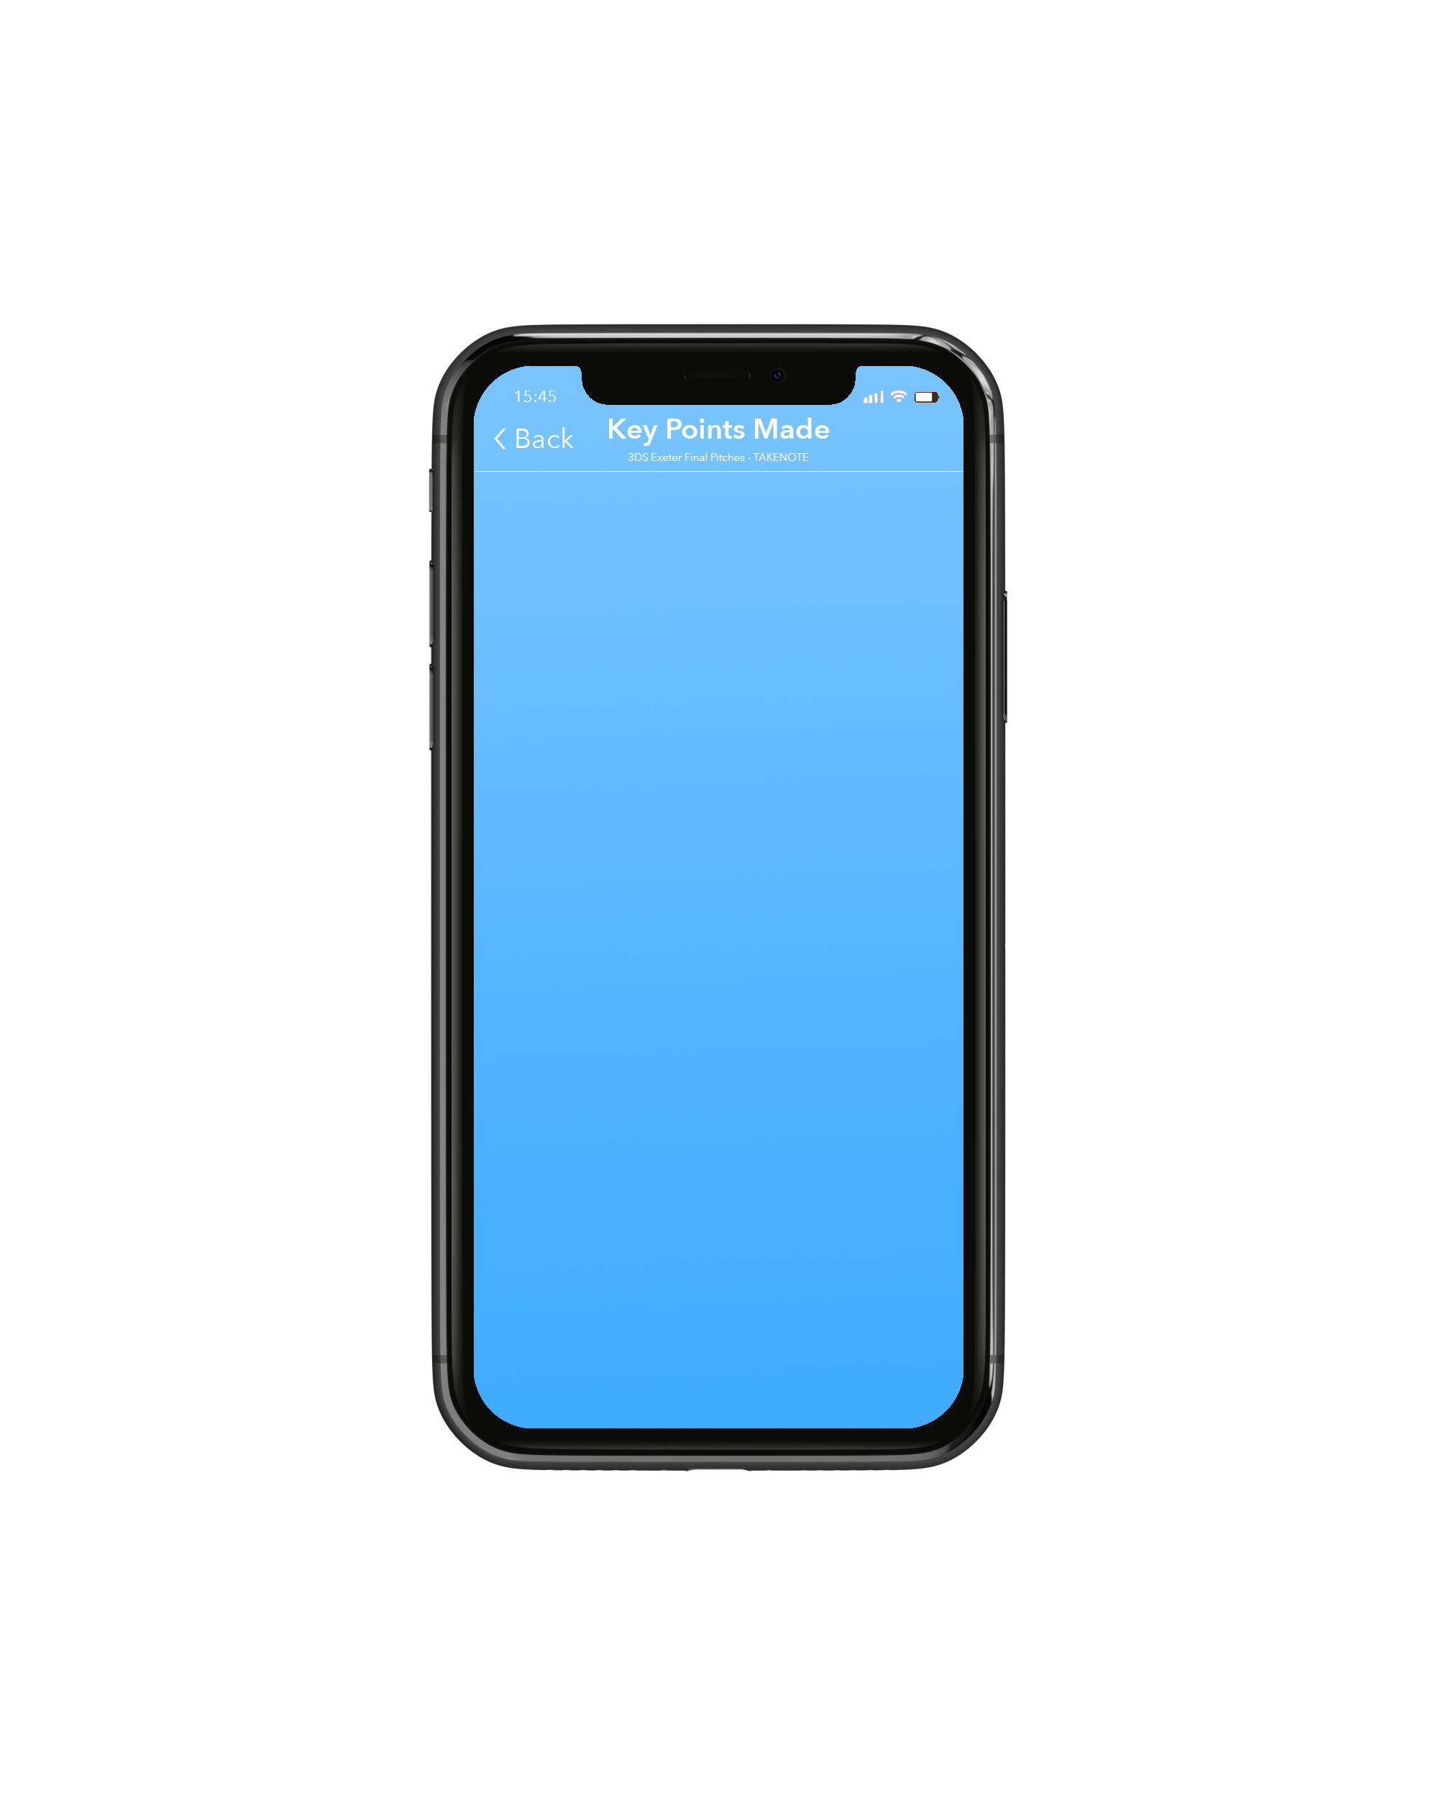

Solution
Claudia
• Takenote transcribes meetings
• Condenses transcript into key points and actions
• Circulates meeting summary in an email immediately
Notes:
- Engineering & business students
- Industrial experience to bring successful product out to market
- Takenote transcribes meetings
- Condenses into key points and actions
-Circulates it in an email immediately

Slide 4
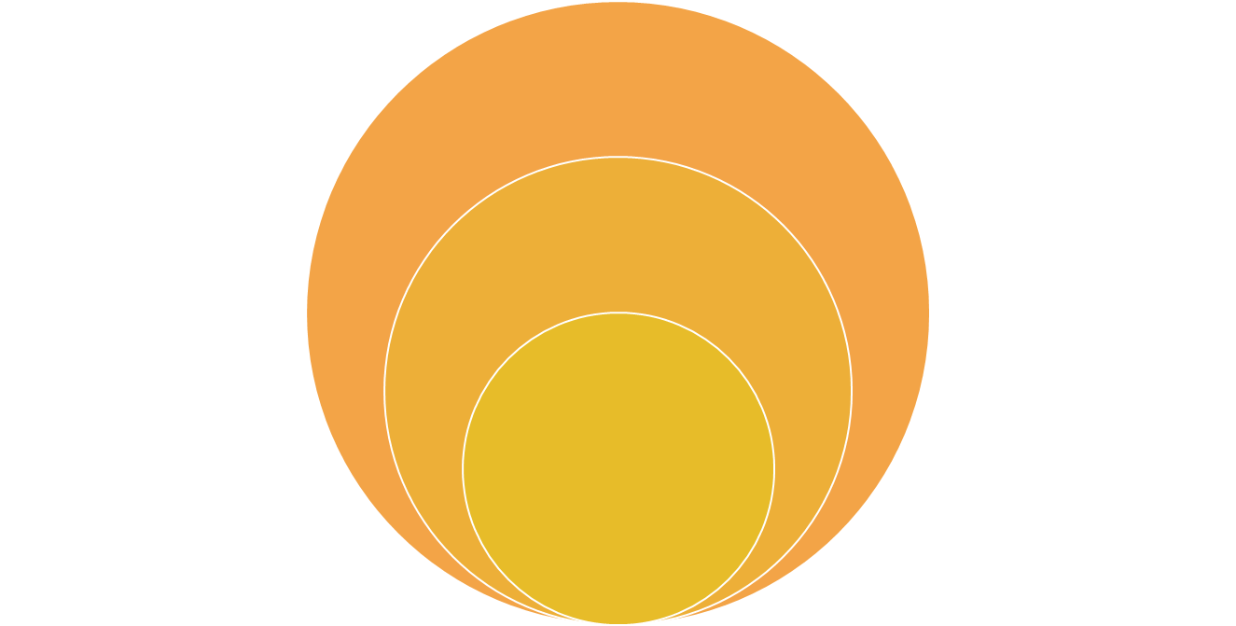

Market Size
Total Addressable:
>421M SMEs
Available:
>18M SMEs
Target:
204K UK Small Enterprises
Teodor
• Total Addressable: 421M SMEs
• Available: 18M SMEs
• Target: 204K SEs
Notes:
Total addressable: 421M SMEs, available: 18M SMEs, target 204k SEs

Slide 5


How to make money?
Monthly subscription packages
£3 / hour of meeting
Teodor
• Subscription based model
• Pay for a package of 10 hrs/week
• Customer price: £3/hour
• Cost to business: £1/hour
• Development Cost: £20,000 over 6 months
Notes:
Subscription based:
Rather than pay per meeting which disincentives people to use the app
Pay for a package of 10 hours / week
$3 / hour of meetings:
Outsourced services to IBM and Google $1 / hour
Development cost $20,000, 6 Months

Slide 6



Market Strategy
Teodor
• Target: Small Enterprises
• Provide incentive to gain feedback
Notes:
Small enterprises, feedback, organic growth

Slide 7



Who we are up against?
1 INDIRECT
COMPETITOR
1 DIRECT
COMPETITOR
Sophie
• 1 direct & 1 indirect competitor
• Both new in huge market
Notes:
In terms of our competitors marketing a similar technology
1 direct, 1 indirect
Both new in huge market
2 competitors

Slide 8



Our competitive advantage
App-based
Face-to-face meetings
Different market
Sophie
• 3 competitive advantages
• App based: easy integration
• Can be used during face-to-face meetings
• Targeting Different Market
Notes:
We have 3 competitive advantages
App based - don’t have to be integrated to current systems
Used during face-to-face meetings - not just conference calls
Targeting different market
App-based
Live meetings
Different market

Slide 9
